Slide 1


DiversAi
DiversAi’s RSRCH
Notes:
Demystifying Research Papers

Slide 2
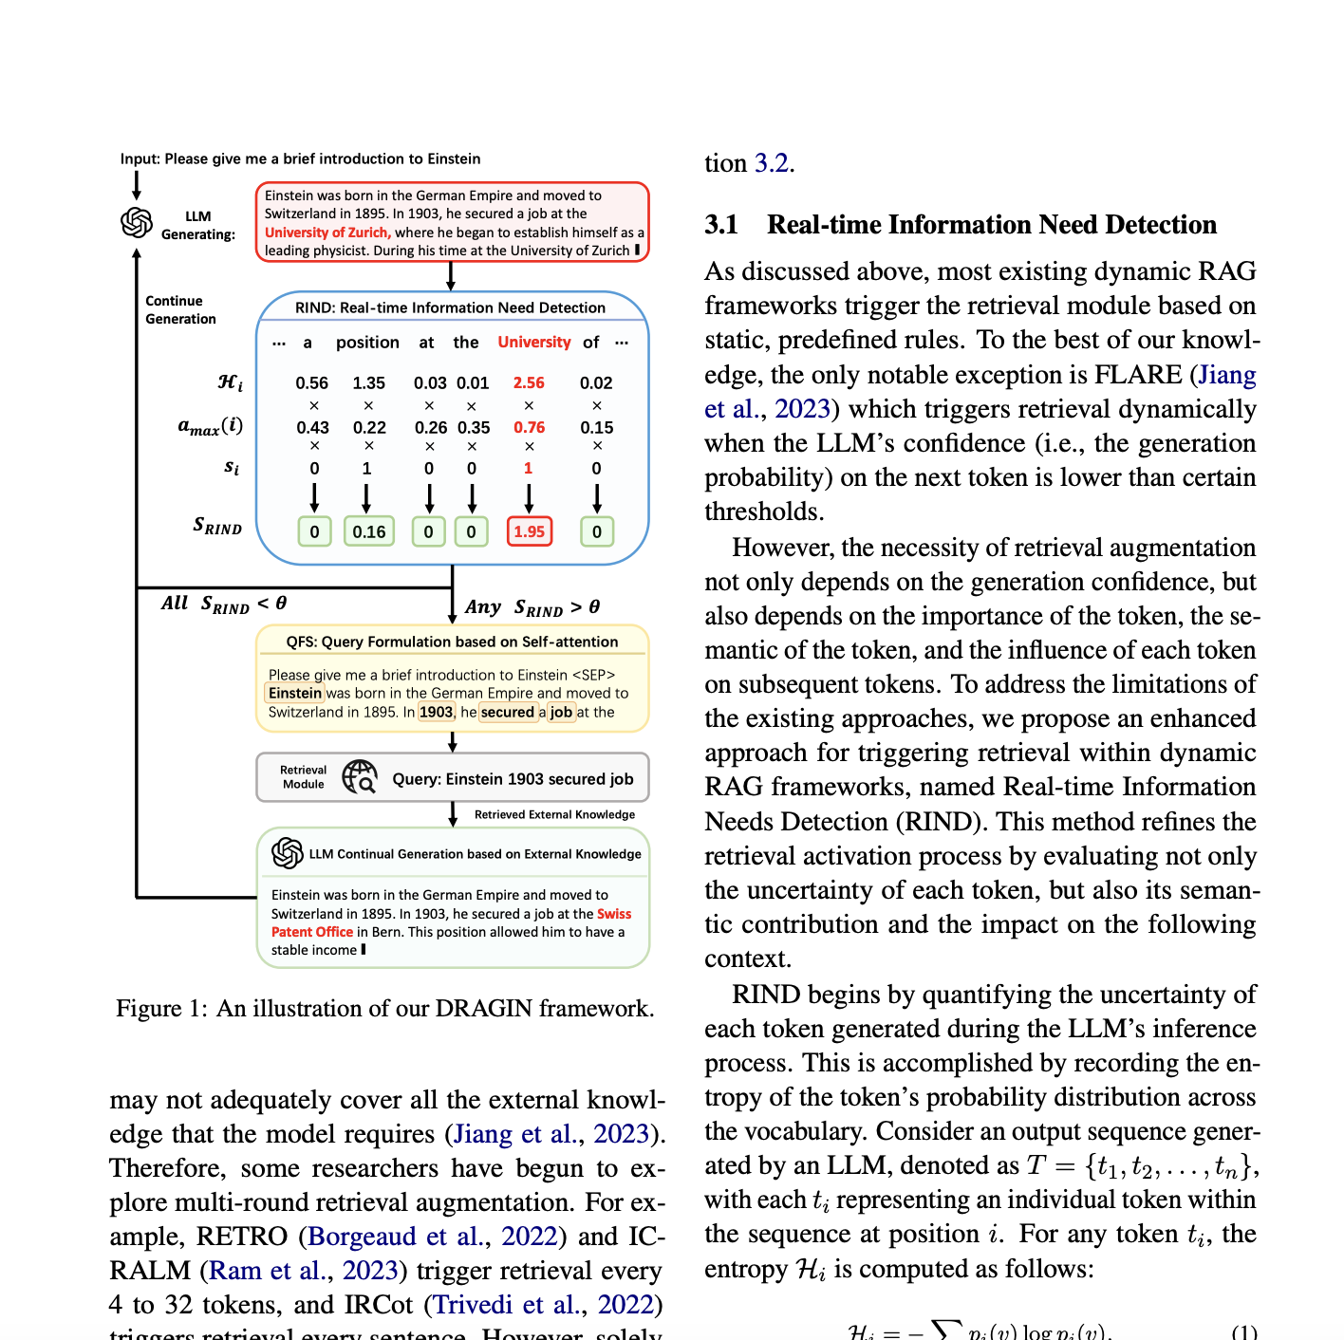
Notes:
Source: https://arxiv.org/pdf/2403.10081

Slide 3




What problem did we solve and why?
2.4 Million Research Papers
Atisha

Slide 4





What is our solution?
RSRCH
100,000+
computer science
articles
Melody
Notes:
Original Dataset: https://huggingface.co/datasets/arxiv-community/arxiv_dataset

Slide 5
Assisted Prompting
I am a [ __ ], what is the most up to date research being done in [ __ ]
Example: [data scientist], [NLP]
In the field of [ __ ], what is the [ __ ] topic in the name of research?
Example: [ mathematics ], [ coolest ]
What are the top 3 topics being researched in [ __ ]
What articles have the most citations in the field of [ __ ]
Give me a summary of the top articles in the field of [ __ ]
What does recent research say about the applications of [_______] in[_________]
Example: [AI, mechanical engineering]
Can you explain the findings of a recent paper about [________ ] in [_________]?
Example: [smart grids][electrical engineering]
I am a student in[________]. What are the top three [__________] in my field right now?
Example: [engineering, emerging technologies]
Melody

Slide 6

Solution Tech Stack
Google Colab → Python
Models:
Embedding: SentenceTransformer → all-MiniLM-L6-v2
LLM: mistral-large-latest
Milvus Cloud: Store embeddings in vector database
Zilliz - 14 day trial
Melody

Slide 7
Demo
Github
Ananya

Slide 8


Next Steps
Deploy Agent online for user testing
Melody

Slide 9
Steps
Dataset
Embedding
Creating Vector Database: Store Embeddings

